Slide 1
Project Presentation
Hamza Zafar
Kashif Mujeeb
Muhammad Farooq

Slide 2
Introduction
Container Terminal Management
Interesting issue because the cost per day may be $65000 of Container Ship.
Whole domain is divided into three parts
Land System
Sea System
Container Terminal System
Focus on Container Terminal Resource Management.

Slide 3
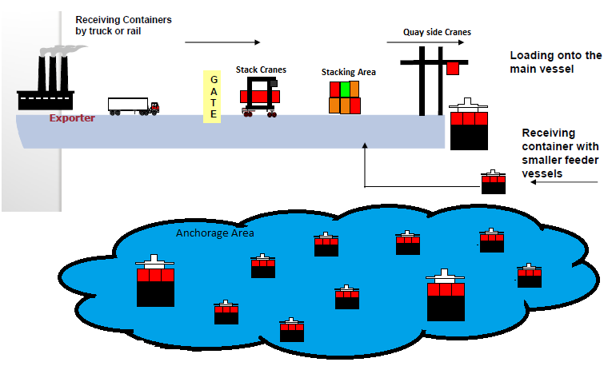
System Diagram

Slide 4
Karachi International Container Terminal
Vessel | Voyage | ETA | ETD | Type | Load | Discharge | ImporterID | Importers | ExporterID | ExporterDistance | Exporters
HYUNDAI BANGKOK | 045E | 07-05-14 4:12 | 07-05-14 9:00 | F | 232 | 344 | imp1 | 2035 | exp1 | 13 | 9224
SAGAMORE | 440 | 06-05-14 11:00 | 07-05-14 11:00 | F | 275 | 167 | imp2 | 3881 | exp2 | 14 | 4609
Y M OAKLAND | 042E | 04-05-14 16:18 | 06-05-14 14:30 | F | 362 |  | imp3 | 2256 | exp3 | 21 | 5603
HYUNDAI GENERAL | 555E | 01-05-14 0:30 | 02-05-14 15:24 | F | 121 | 292 | imp4 | 2714 | exp3 | 47 | 1348
NORTHERN PRELUDE | 38 | 30-04-14 13:00 | 01-05-14 19:00 | F | 468 |  | imp5 | 1785 | exp4 | 28 | 8776
PAC ARIES | 20 | 30-04-14 9:24 | 01-05-14 5:12 | F |  | 201 |  |  | exp5 | 49 | 3592
OOCL NEW YORK | 004E | 27-04-14 22:24 | 30-04-14 5:30 | F | 460 | 245 |  |  | exp6 | 23 | 7685
NORTHERN POWER | 022E | 27-04-14 20:30 | 29-04-14 8:42 | F | 250 | 310 |  |  | exp7 | 40 | 8799
APL SEATTLE | 86 | 24-04-14 20:12 | 26-04-14 7:18 | F |  | 80 |  |  | exp8 | 43 | 3573
PAC ARIES | 19 | 23-04-14 14:30 | 24-04-14 11:18 | F | 127 |  |  |  | exp9 | 47 | 5556
COSCO KAWASAKI | 021E | 23-04-14 6:18 | 24-04-14 16:30 | F | 155 |  |  |  | exp10 | 12 | 8181
SAGAMORE | 439 | 22-04-14 11:48 | 23-04-14 3:12 | F | 106 | 357
MOL DIGNITY | 030E | 20-04-14 19:30 | 22-04-14 8:06 | F | 492 | 37
YM EMINENCE | 043E | 20-04-14 15:10 | 22-04-14 21:54 | F | 386 | 205
APL SOKHNA | 75 | 17-04-14 13:30 | 19-04-14 7:54 | F |  | 212
APL SOKHNA | 76 | 08-05-14 10:00 | 10-05-14 1:00 | M | 9800 | 6410
EVER RESULT | 039E | 07-05-14 18:12 | 08-05-14 21:00 | M | 2976 | 11311
PAC ARIES | 21 | 07-05-14 15:50 | 08-05-14 6:00 | M | 3672 | 6280
MOL DIRECTION | 028E | 04-05-14 17:48 | 05-05-14 23:12 | M | 14800 | 14785
APL SYDNEY | 177 | 01-05-14 13:42 | 03-05-14 11:12 | M | 6910 | 14131
NORTHERN PRELUDE | 038E | 30-04-14 15:00 | 01-05-14 21:00 | M | 7034 | 5652
HYUNDAI CONFIDENCE | 527E | 21-04-14 16:54 | 23-04-14 19:12 | M | 9916 | 14173

Slide 5
Resources Available
Resources Available AT KITC
Berths--> 3
Mother Container --> 2
Feeder Container --> 1
Quay Side Cranes --> 11
Yard Tractors (inTransport) --> 68
Stack Cranes --> 39
Container Capacity --> 38576 TEU
Tugs --> 10

Slide 6
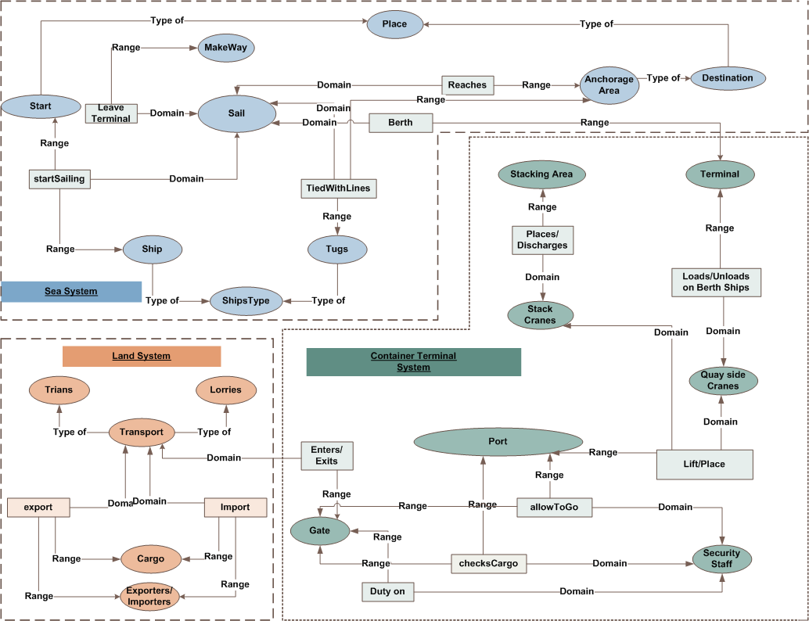
Ontology

Slide 7
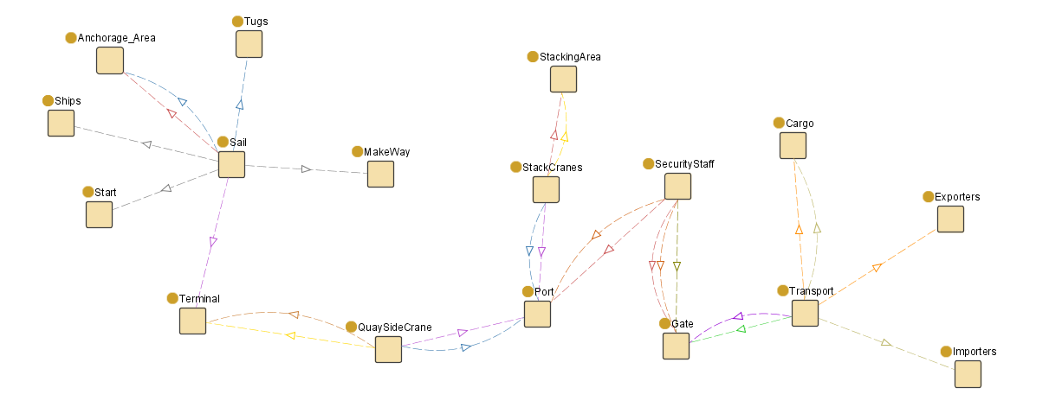
Ontology (Protégé)

Slide 8
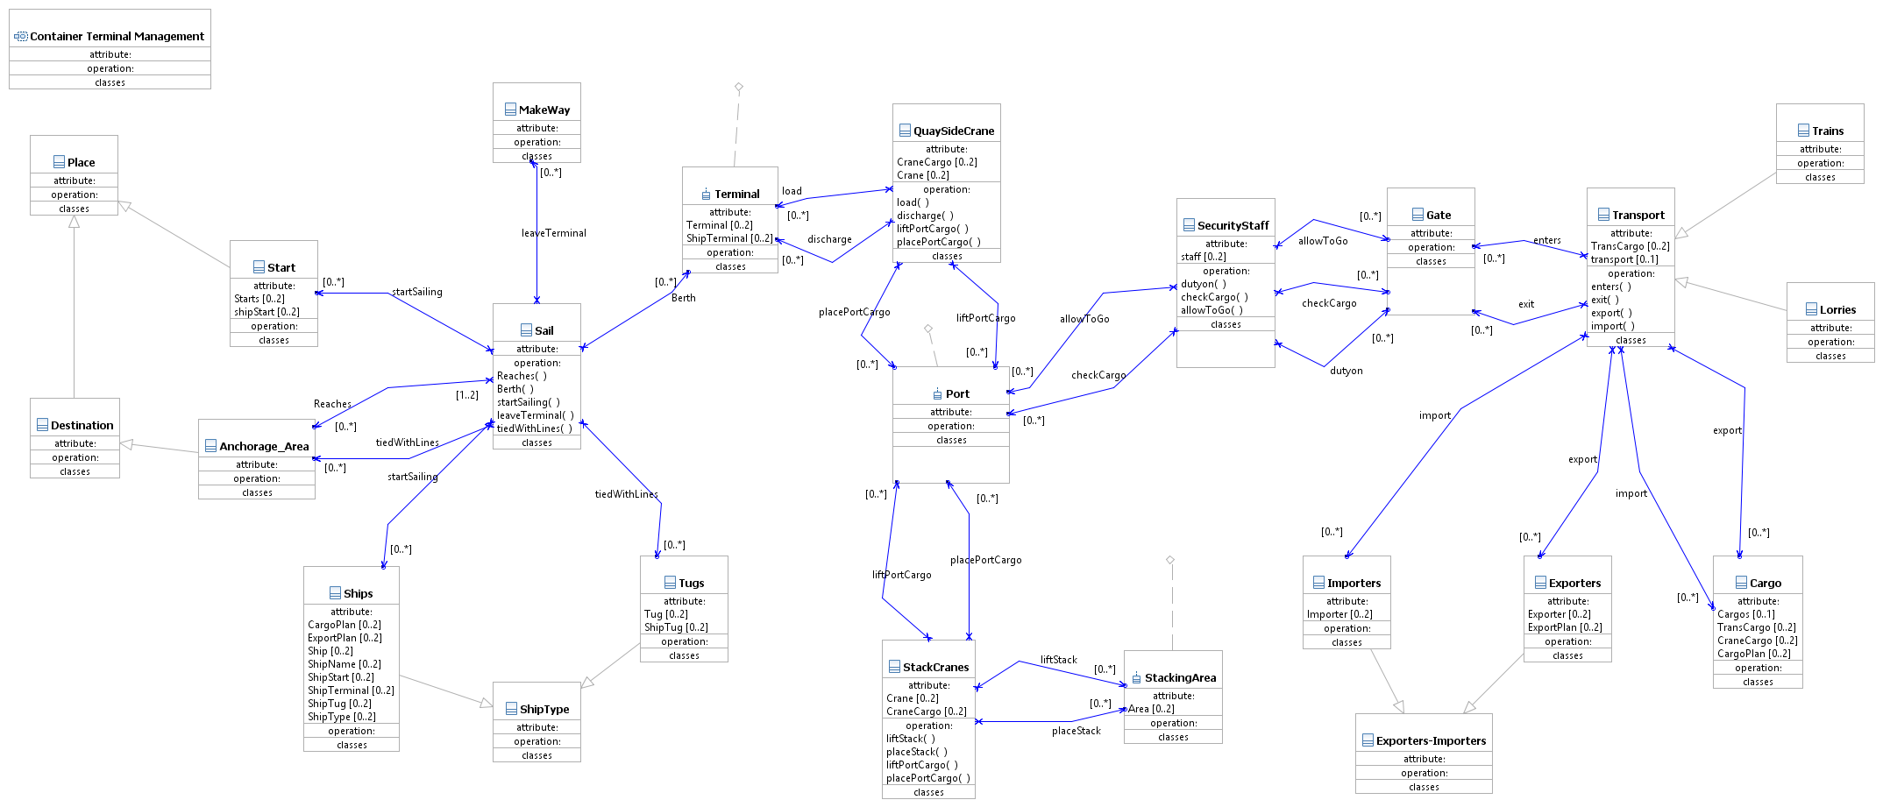
Class Diagram

Slide 9
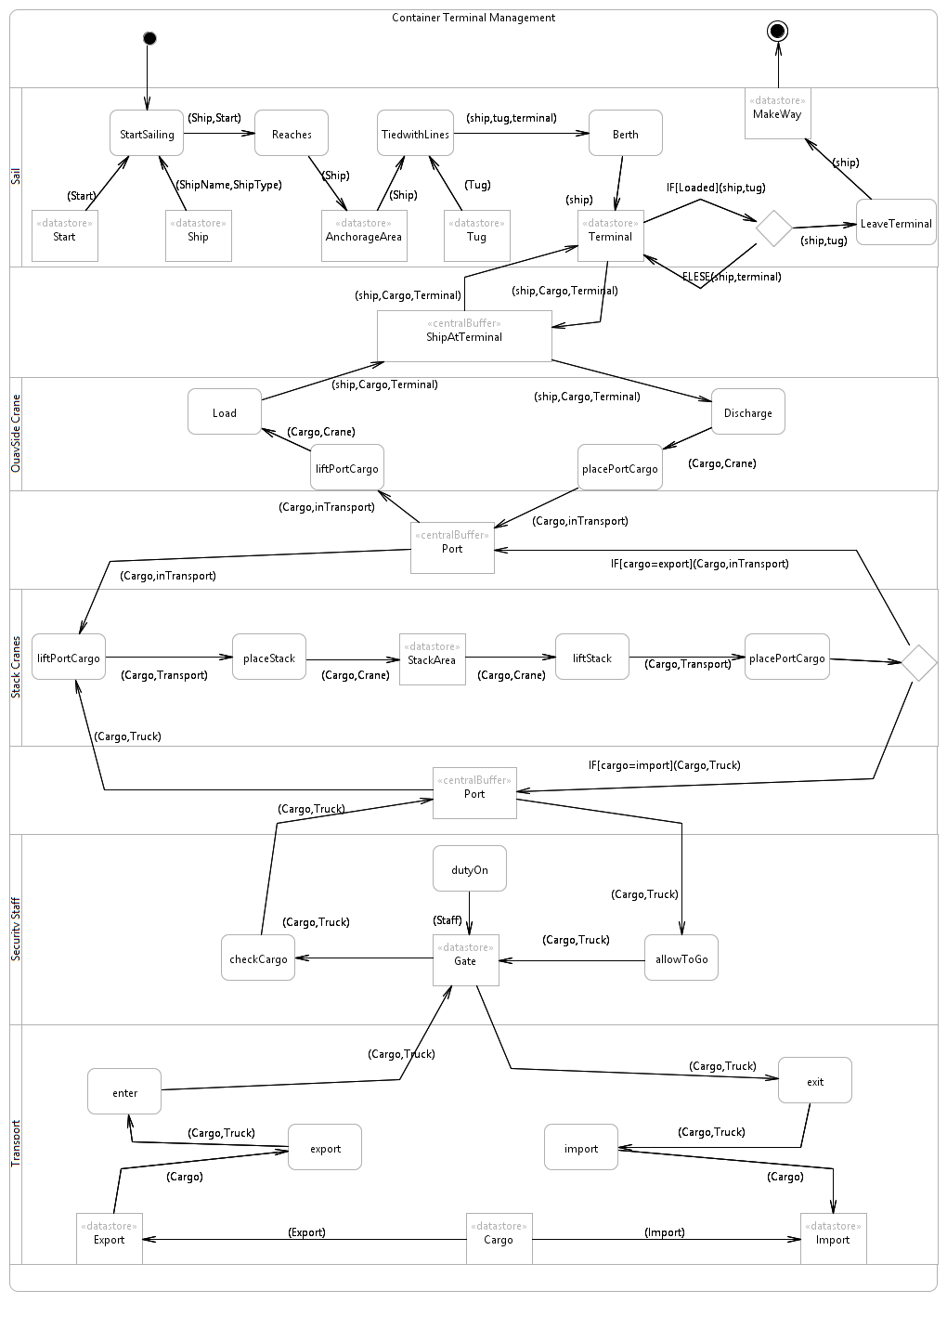
Activity Diagram

Slide 10
System Multiple Views
The Three view of System Engineering is kept in mind
The Ontology and CPN Super Page shows the System view
The Sub Pages and Object properties are made; That represents Operational view
Sub pages of sub pages are made for the Technical views

Slide 11
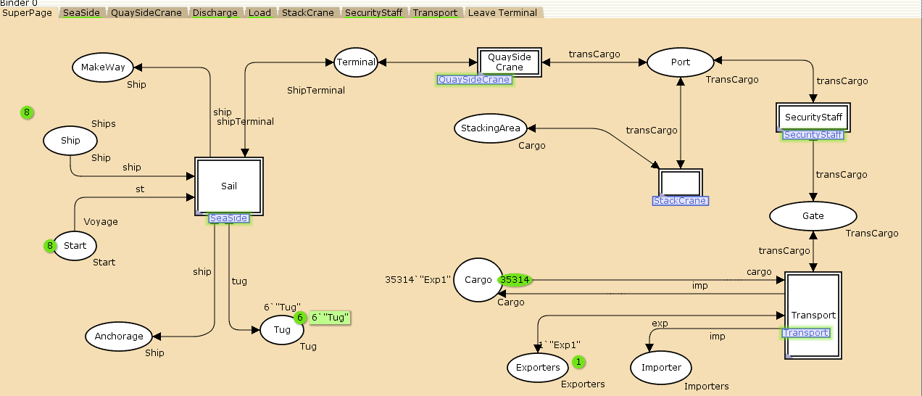
System View

Slide 12
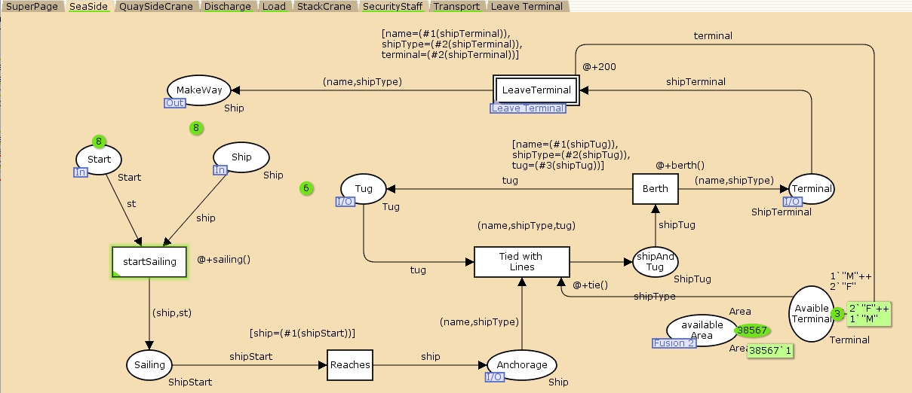
Operational View

Slide 13
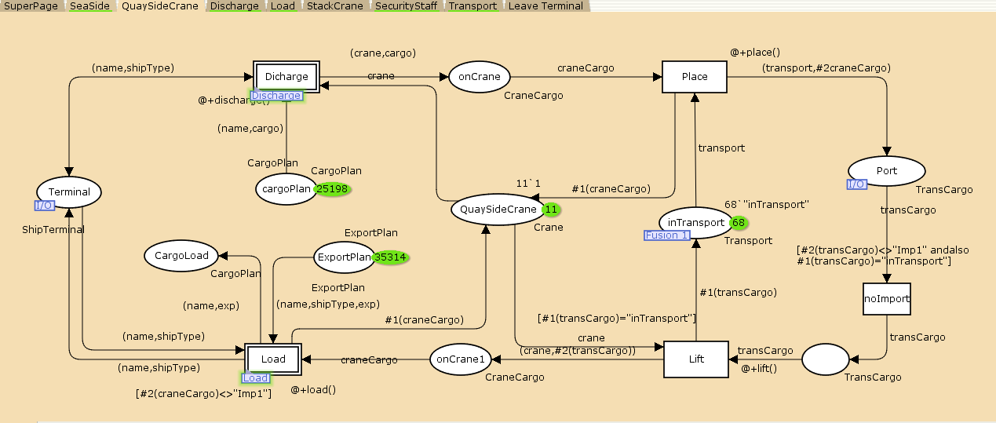
Operational View

Slide 14
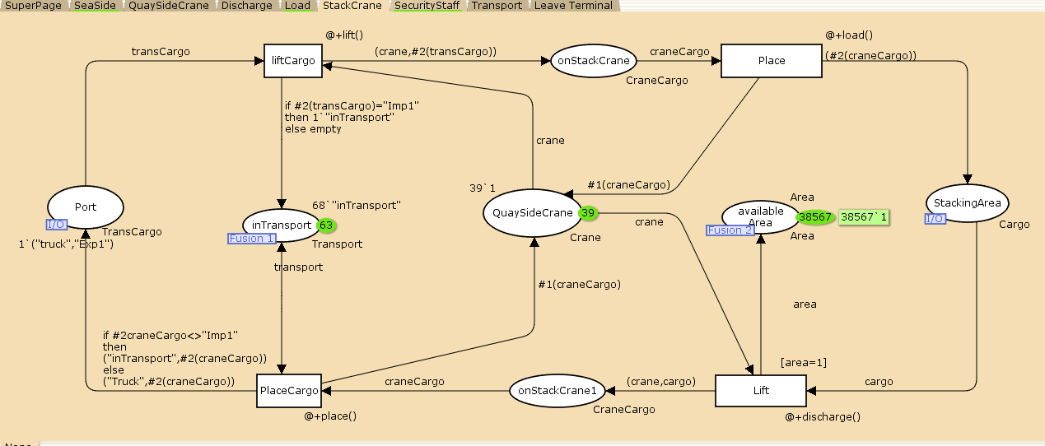
Operational View

Slide 15
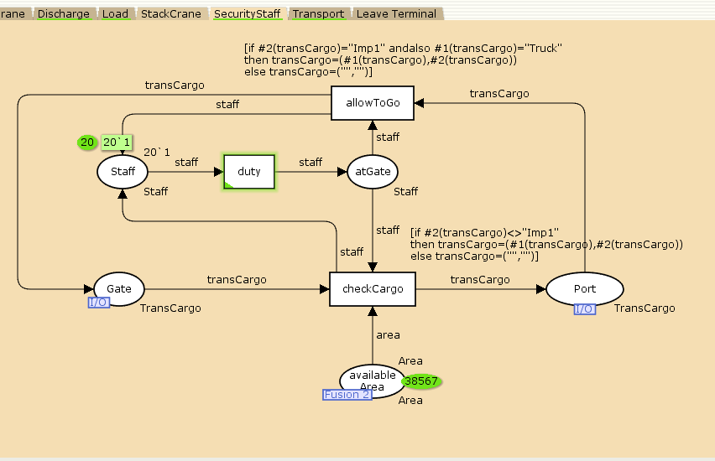
Operational View

Slide 16
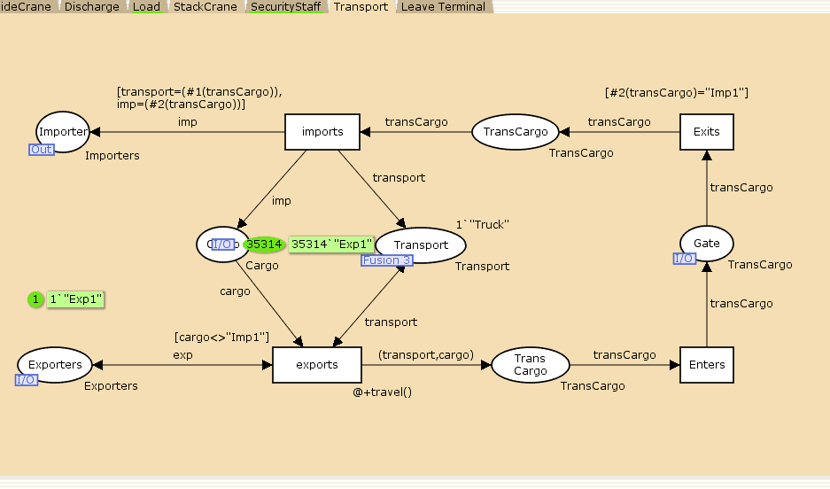
Operational View

Slide 17
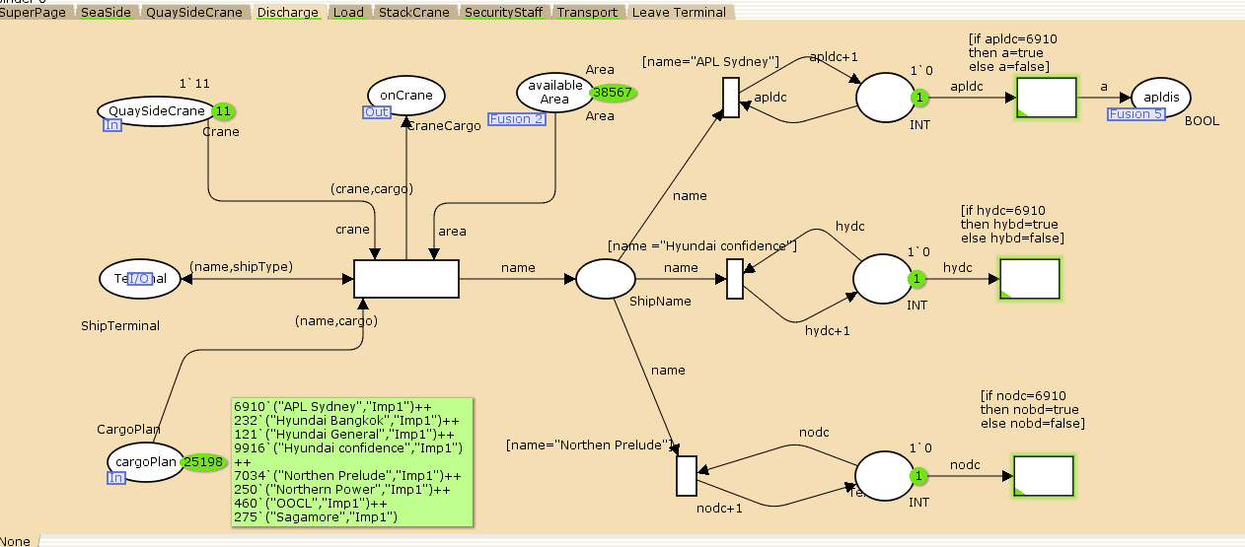
Technical View

Slide 18
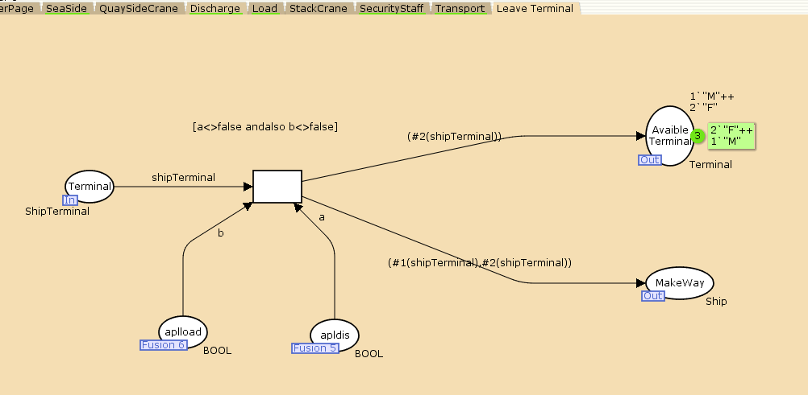
Technical View

Slide 19
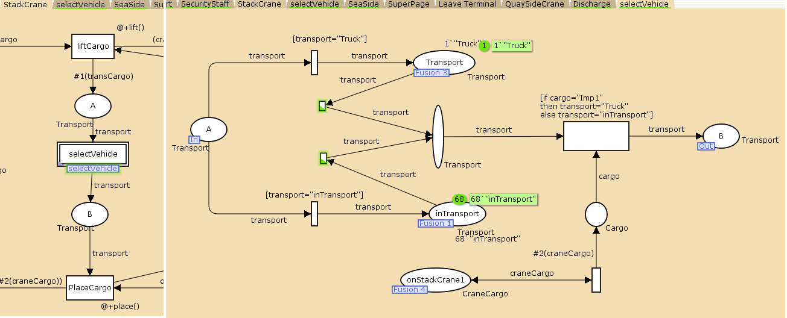
Technical View

Slide 20
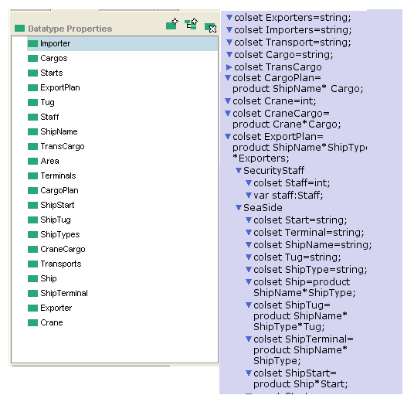
Mapping
Concepts Mapping
Object Properties
Data Type Properties

Slide 21


Mapping
SWRL AND IF Condition
Cargo(?c) ∧
Transport(?t) ∧
allowToGo(?t, ?c) ∧
swrlb:equal(?c, "Imp1") ∧
swrlb:equal(?t, "Truck")
→ abox:setValue(?t, "Truck") ∧
abox:setValue(?c, "Imp1")
Cargo(?c) ∧
Transport(?t) ∧
checksCargo (?t, ?c) ∧
swrlb:equal(?c, "Exp1")
→ abox:setValue(?t, "Truck") ∧
abox:setValue(?c, "Exp1"

Slide 22
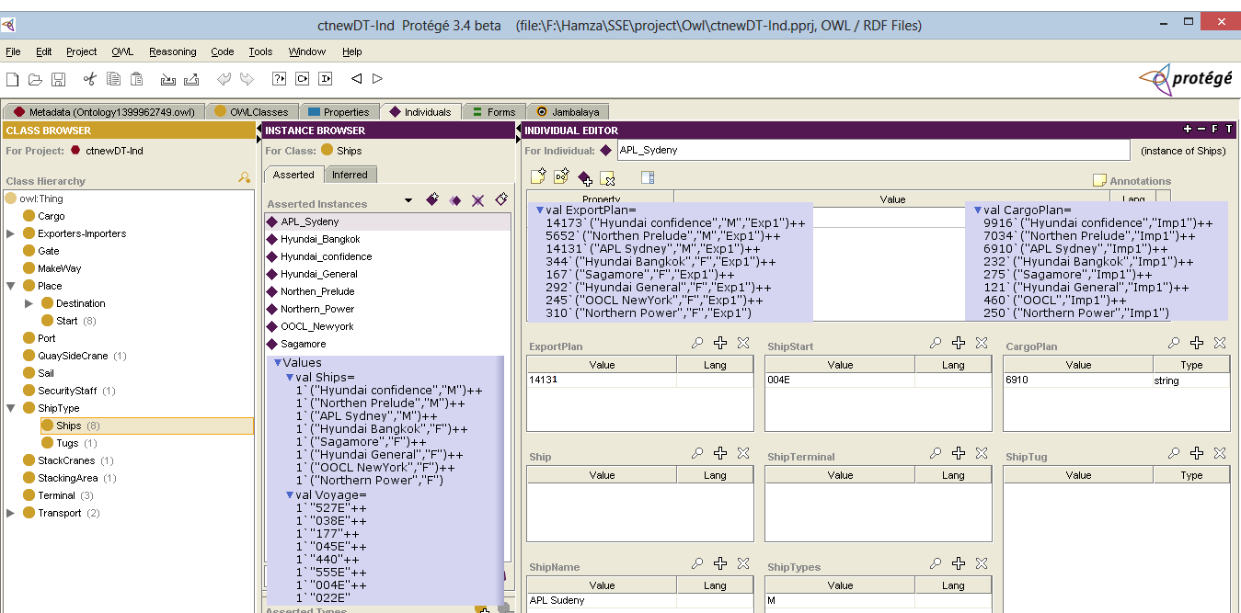
Mapping (Instances)

Slide 23
Conclusion and Future Work
Time is used but can not be evaluated.
Technical view may be described more; having more swrl and if (guard) condition.
The Resource e.g Cranes, Security Staff and Terminal Capacity may be simulated very well.

